Slide 1
Lesson objective
Title: Real life linear
Aim:
Create rules from real life linear problems
Plot and compare from a table of values
Plan:
Review: creating rules
Plotting from real life situations
Whiteboards rulers and calculators.
PBiS focus: Empathy
Support and include others.

Slide 2

Demonstration
Create a table of values
Determine where the pattern starts (0 shapes)
Find the common difference
Make a rule
Number of shapes | 0 | 1 | 2 | 3 | 4 | 5
Number of matches |  | 6 | 11 | 16
RULE: Number of matches = ______ x the number of shapes + ________

Slide 3

You try ➔ whiteboards
Create a table of values
Determine where the pattern starts (0 shapes)
Find the common difference
Make a rule
RULE: Number of matches = ______ x the number of shapes + ________

Slide 4

You try ➔ whiteboards
Create a table of values
Determine where the pattern starts (0 shapes)
Find the common difference
Make a rule
RULE: Number of matches = ______ x the number of shapes + ________

Slide 5

You try ➔ whiteboards
Create a table of values
Determine where the pattern starts (0 shapes)
Find the common difference
Make a rule

Slide 6
When, oh when, would I ever use this nonsense?
StopYaLeaking Plumbing charges a $100 callout fee then $70 per hour
SteadyFlow Plumbing charges a straight $100 per hour
 | 0 hour | 1 hour | 2 hours | 3 hours | 4 hours | 5 hours
StopYaLeaking
SteadyFlow
MAKE A RULE
Cost (SYL) =
Cost (STF) =

Slide 7

 | 1 hour | 2 hours | 3 hours | 4 hours | 5 hours
StopYaLeaking
SteadyFlow
$170
$240
$310
$380
$450
$100
$200
$300
$400
$500
Cost
500
400
300
200
100
Hours
1
2
3
4
5
6

Slide 8
 | 0 hour | 1 hour | 2 hours | 3 hours | 4 hours | 5 hours
StopYaLeaking
SteadyFlow
Cost
500
400
300
200
100
Hours
1
2
3
4
5
6

Slide 9
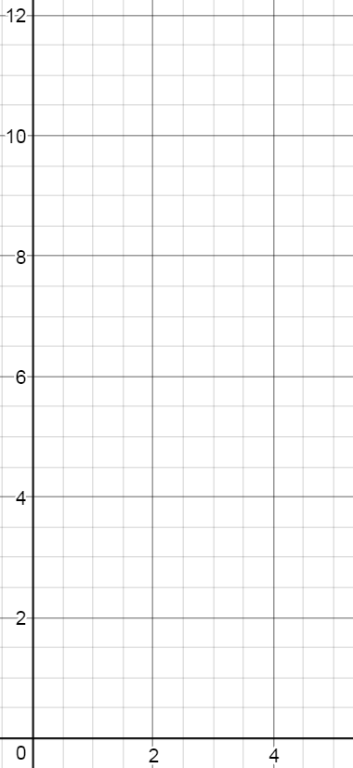
When, oh when, would I ever use this nonsense?
SafenSound Taxis charge $5 flagfall then $1 per km
FastnFurious Taxis charge $2 flagfall then $2 per km
Complete a table of values
Plot each sequence on a number plane
Create a rule for each
Which is cheaper after 9kms?
Table of values | 0 km | 1 km | 2 km | 3 km | 4 km | 5 km
SafenSound
FastnFurious

Slide 10
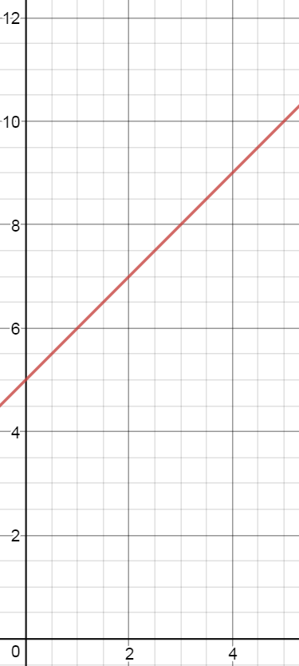
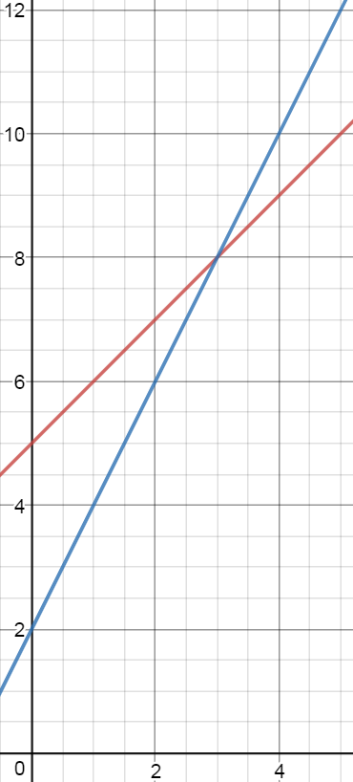
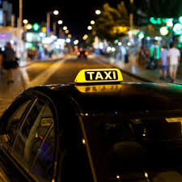
When, oh when, would I ever use this nonsense?
SafenSound Taxis charge $5 flagfall then $1 per km
FastnFurious Taxis charge $2 flagfall then $2 per km
Complete a table of values
Plot each sequence on a number plane
Create a rule for each
Which is cheaper after 9kms?
 | 1 km | 2 km | 3 km | 4 km | 5 km
SafenSound
FastnFurious
$6
$7
$8
$9
$10
$4
$6
$8
$10
$12

Slide 11
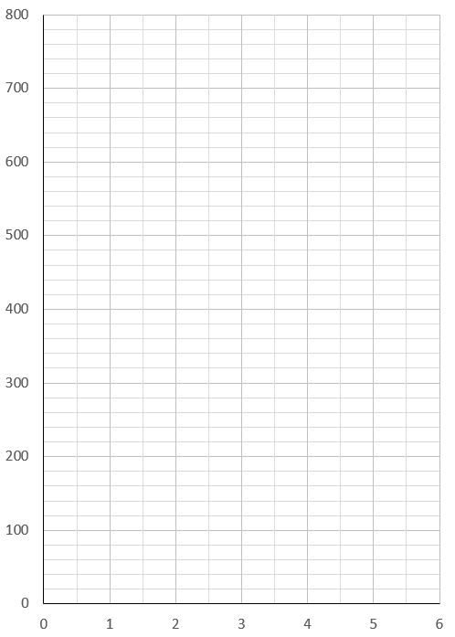
Who to choose?
Shocking Electrical Services charges $100 callout fee then $90 per hour
DownToEarth Electricians charge a flat $110 per hour
Complete the table and draw the graphs
Which service would you choose, and why?
  For jobs that are ………. hours long, I would choose …………… because …….
How much would the cheapest company charge for a full week-long (38 hour) job?
How can you tell from the graph when both companies charge the same amount?
  The graph shows when both companies charge the same amount because…………
 | 0 hr | 1 hr | 2 hr | 3 hr | 4 hr | 5 hr
Shocking
DownToEarth

Slide 12
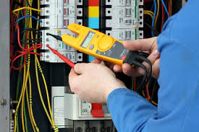
Who to choose?
Shocking Electrical Services charges $100 callout fee then $90 per hour
DownToEarth Electricians charge a flat $110 per hour
Complete the table and draw the graphs
Which service would you choose, and why?
  For jobs that are ………. hours long, I would choose …………… because …….
How much would the cheapest company charge for a full week-long (38 hour) job?
How can you tell from the graph when both companies charge the same amount?
  The graph shows when both companies charge the same amount because…………
x
Shocking
x
x
x
x
x
x
x
x
x
DownToEarth
x
 | 0 hr | 1 hr | 2 hr | 3 hr | 4 hr | 5 hr
Shocking | $100 | $190 | $280 | $370 | $460 | $550
DownToEarth | $0 | $110 | $220 | $330 | $440 | $550

Slide 13
Individual practice
Page 124
Questions 1 – 12
In your exercise book

